Slide 1

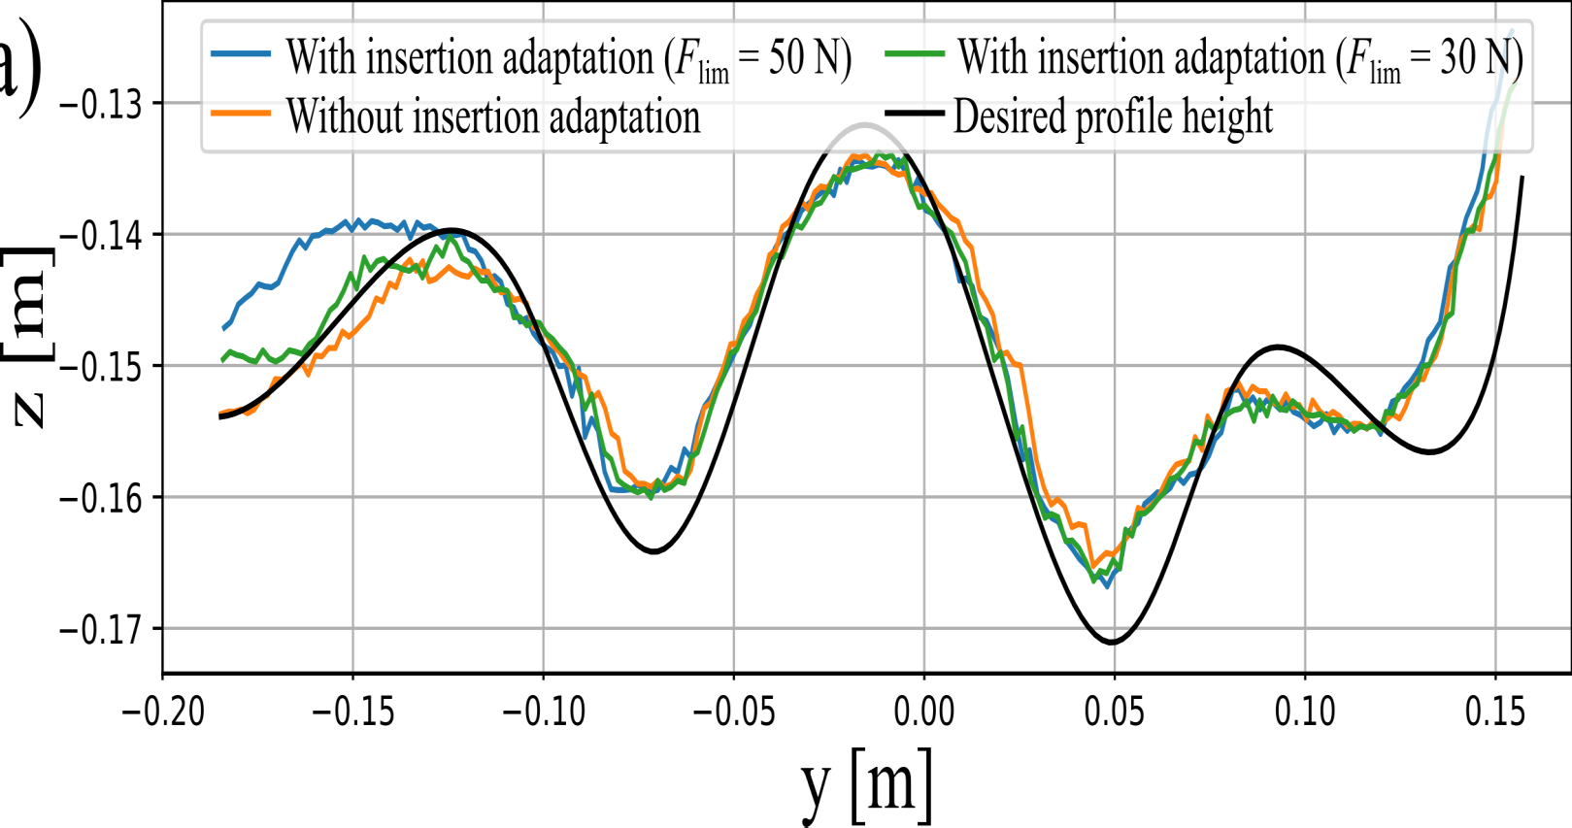
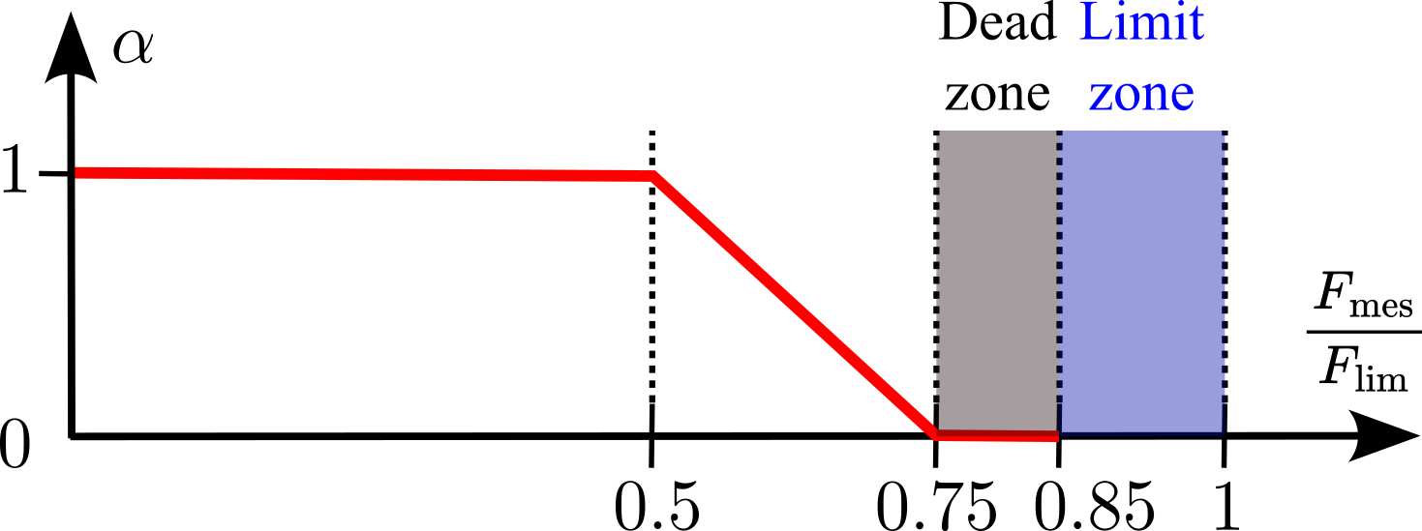
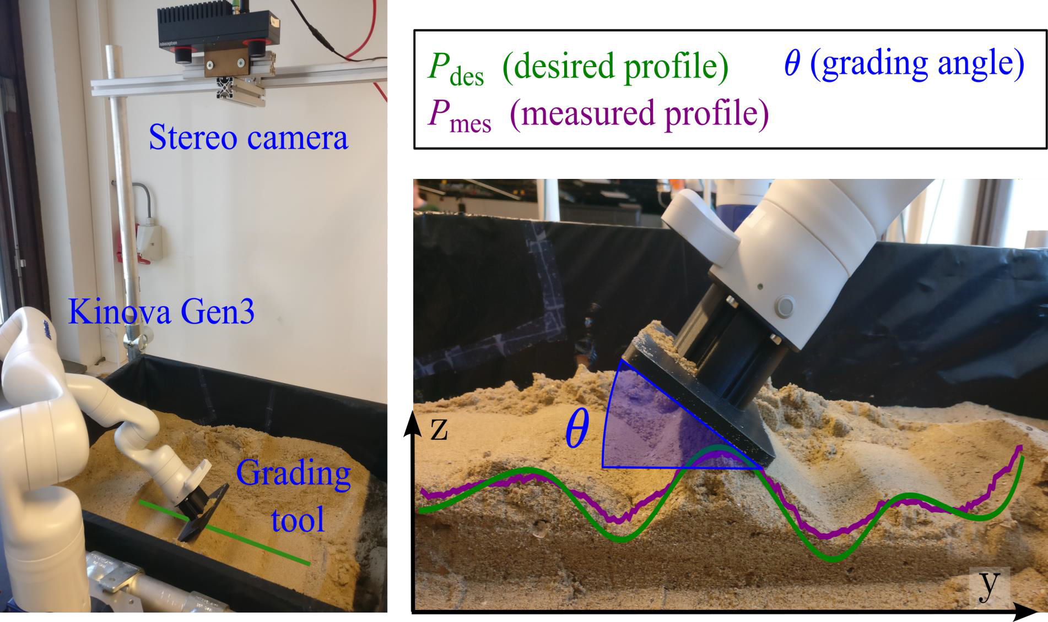
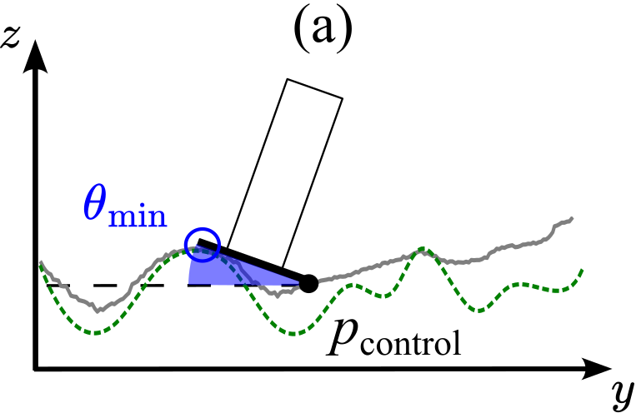
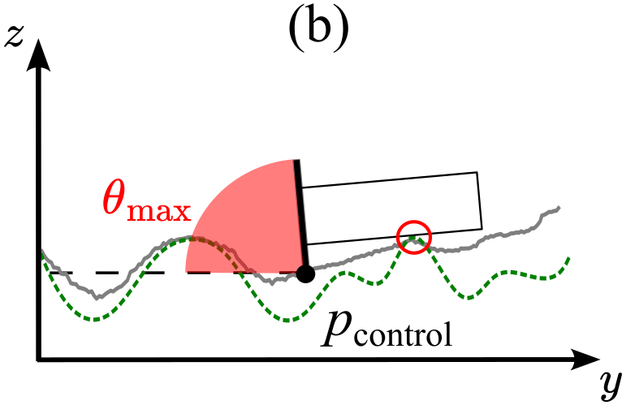
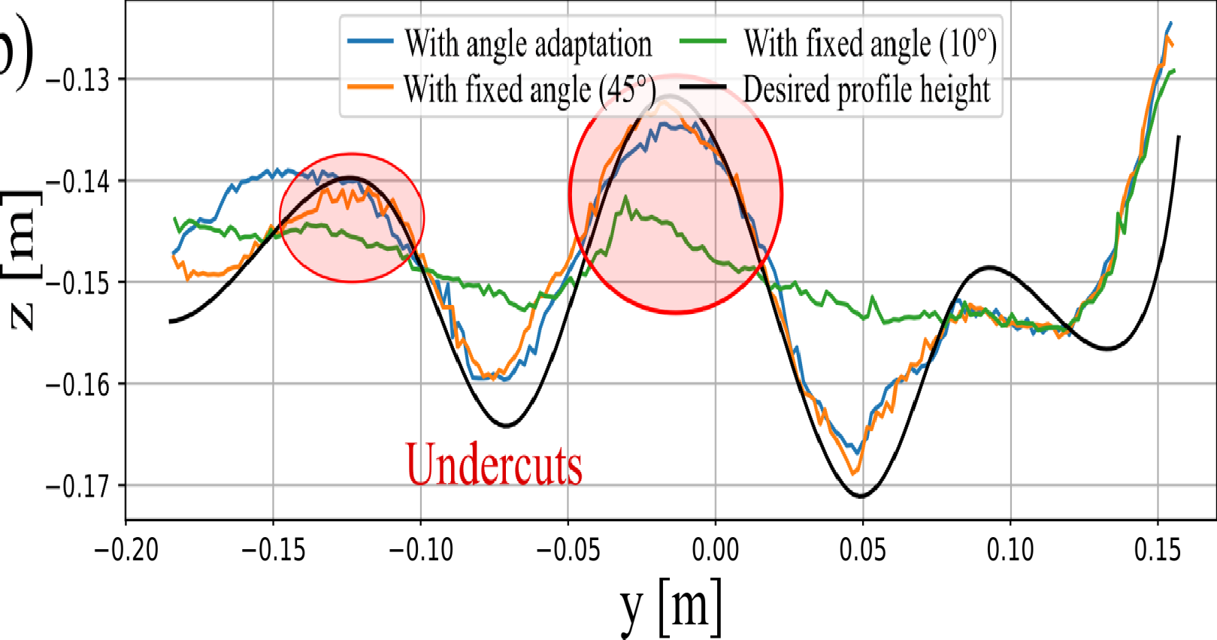
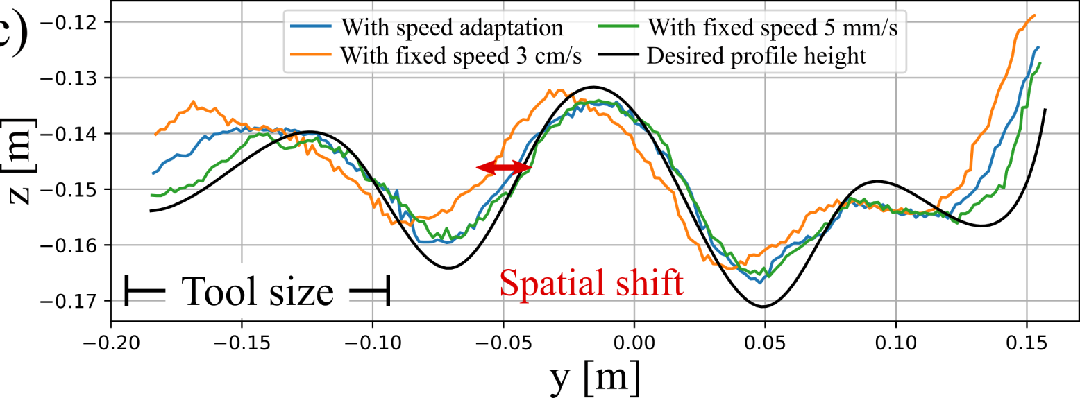
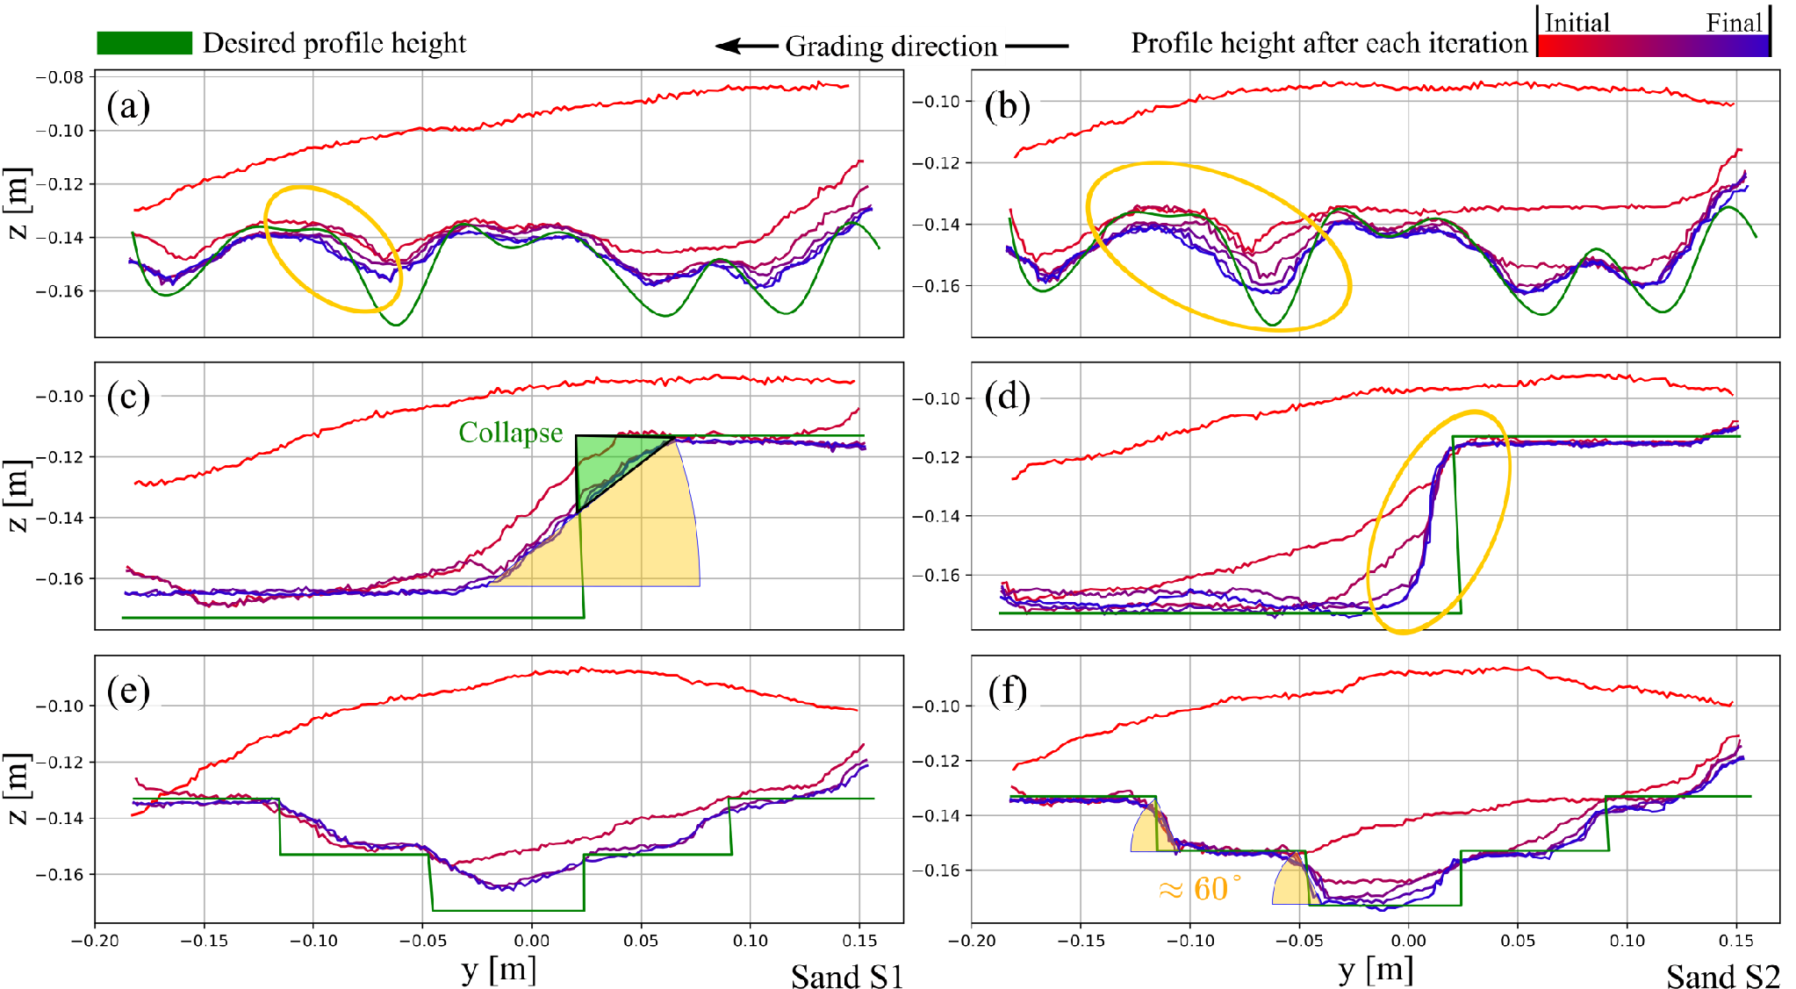
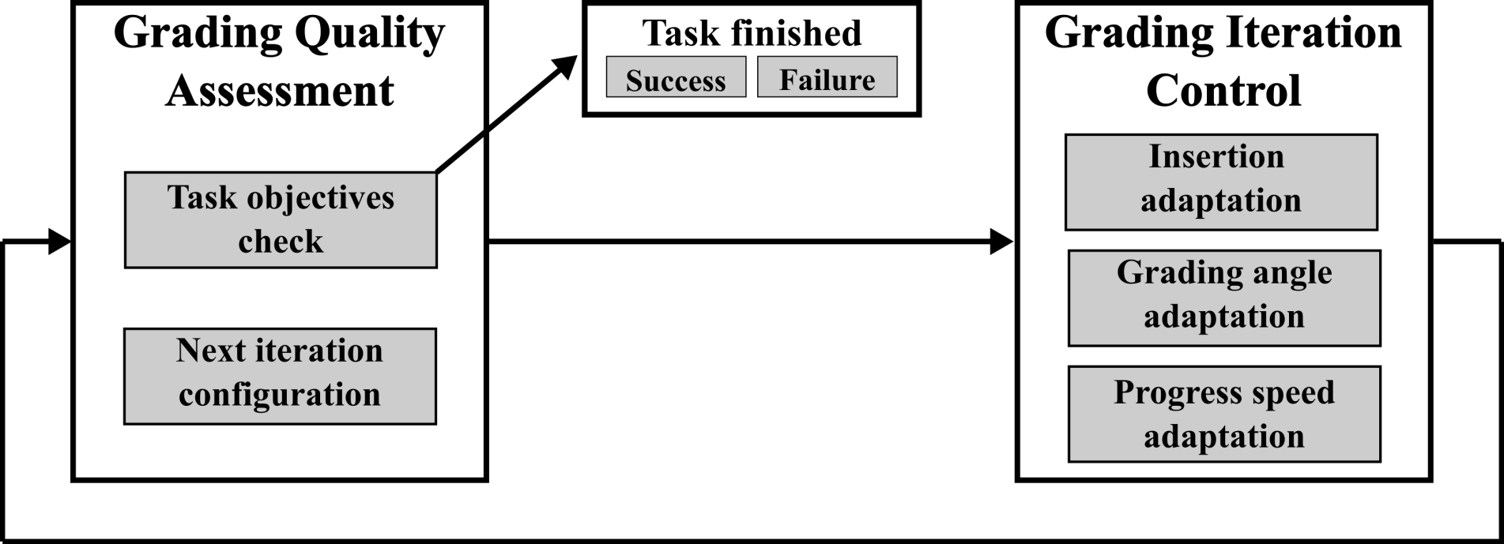
MASIMA, BONOLO
3175764M
Counterfactual Diagnosis of Robotic Grasp Failures under Perceptual and Geometric Degradation
Amorphous materials are involved in many construction applications: excavation, shotcreting, plastering …
Tool insertion adaptation reduces force violations during tool-material interactions.
Interaction forces may vary significantly during contact and even exceed the robot’s limits.
→ Tool insertion is regulated based on interaction force, allowing deviations from the desired profile if necessary.
Results: The obtained profiles are geometrically similar.
Challenges:
Sand properties, like for other amorphous materials, are difficult to estimate and emergent effects such as collapses may occur which both influence the manipulation outcome.
→ As humans typically work, we propose an approach where we iterate and adapt the manipulation actions to the observed and desired material states.
^{𝑣}z ^{= 𝑘 (𝑧}setpoint ^{− 𝑧}mes⁾
^{𝑧}setpoint ^{= 𝑧}mes ^{+ 𝛼 (𝑧}des ^{− 𝑧}mes⁾
Insertion via a simple proportional velocity controller in which 𝑧_{setpoint} is adjusted through
𝛼 based on measured force.
Configuration | 𝐹_{lim} = 30 N 𝐹_{lim} = 50 N
Insertion Adaptation | On | Off | On | Off
Sand level S2 | 8.09 | 18.28 | 4.96 | 9.88
Sand level S3 | 6.86 | 21.25 | 4.68 | 11.29
However, adaptation reduces at least 50% of force violations.
Why are force violations still observed?
They occur at profile summits when tool angle changes rapidly (angle adaptation does not consider material accumulation).
We study sand profile grading, a task to obtain a desired geometric curve in sand.
Grading angle adaptation switches between cutting and smoothing behaviors, while avoiding undercuts and collisions.
Speed adaptation provides a balance between grading precision and execution time.
→ We take advantage of the task progress to switch between rapid grading when the objective is still far and then work with more precision for the finishing steps (like humans typically work).
Constraints to avoid undercutting and robot-material collisions.
Skill-based behaviors defining cutting and smoothing angles depending on task progress.
𝑧_{mes} − 𝑧_{des} [mm] ^{𝑣}progress ^{[mm/s]} | <2 | ]2;5] | ]5;10] | >10
 | 5 | 10 | 20 | 30
Velocity [mm/s] | 5 | 30 | Adaptive
Obtained PE [mm] | 5.03 | 9.19 | 5.66
Execution time [s] | 254.63 | 89.93 | 200.8
Objectives:
Minimize the profile error (RMSE between measured and desired profiles).
Obtain a smooth surface finish.
Results:
A fixed low angle (see green curve) leads to undercutting.
Higher velocities (e.g., fixed at 3 cm/s) cause a spatial shift between the obtained and desired profiles.
Constraints:
Respect the dynamical limits of the robot.
Avoid undercuts (i.e. grading deeper than desired profile).
Simplification assumptions:
𝑃_{init} is higher than 𝑃_{des} everywhere
→ Subtractive grading.
Material is graded along a 1D straight line trajectory.
Grading quality is limited by material constraints and emergences.
The material itself imposes constraints, such as the repose angle (material stability). Wetter sand can be graded steeper than dry sand.
Emergent effects such as Collapses or Accumulation Shifts (Fig. (a) and (b)) occur when grading complex profiles. Those effects can not be resolved, resulting in significant deviations from the desired profile. 🡺 Future work: emergence handling mechanisms or monitors to adapt world model and robot capabilities for next executions.
Our layered framework separates the manipulation problem into different abstraction levels..
The iterative grading process uses two control levels:
In short, we present a framework for iterative sand profile grading that employs simple adaptation rules relying on limited knowledge of the material behavior.
The Grading Iteration Control: adapts the robot’s motion during one grading iteration to account for material properties and achieve the task objectives while respecting constraints.
The Grading Quality Assessment evaluates the task objectives in between iterations to determine whether the task is finished, or another iteration is necessary.
By extending this work with advanced high-level decision making, we envision the potential for generalizing to 2D surface grading and other amorphous materials manipulation tasks, automating a broader range of construction tasks.
Funded by the European Union. Views and opinions expressed are however those of the author(s) only and do not necessarily reflect those of the European Union or HADEA. Neither the European Union nor the granting authority can be held responsible for them.

